Slide 1
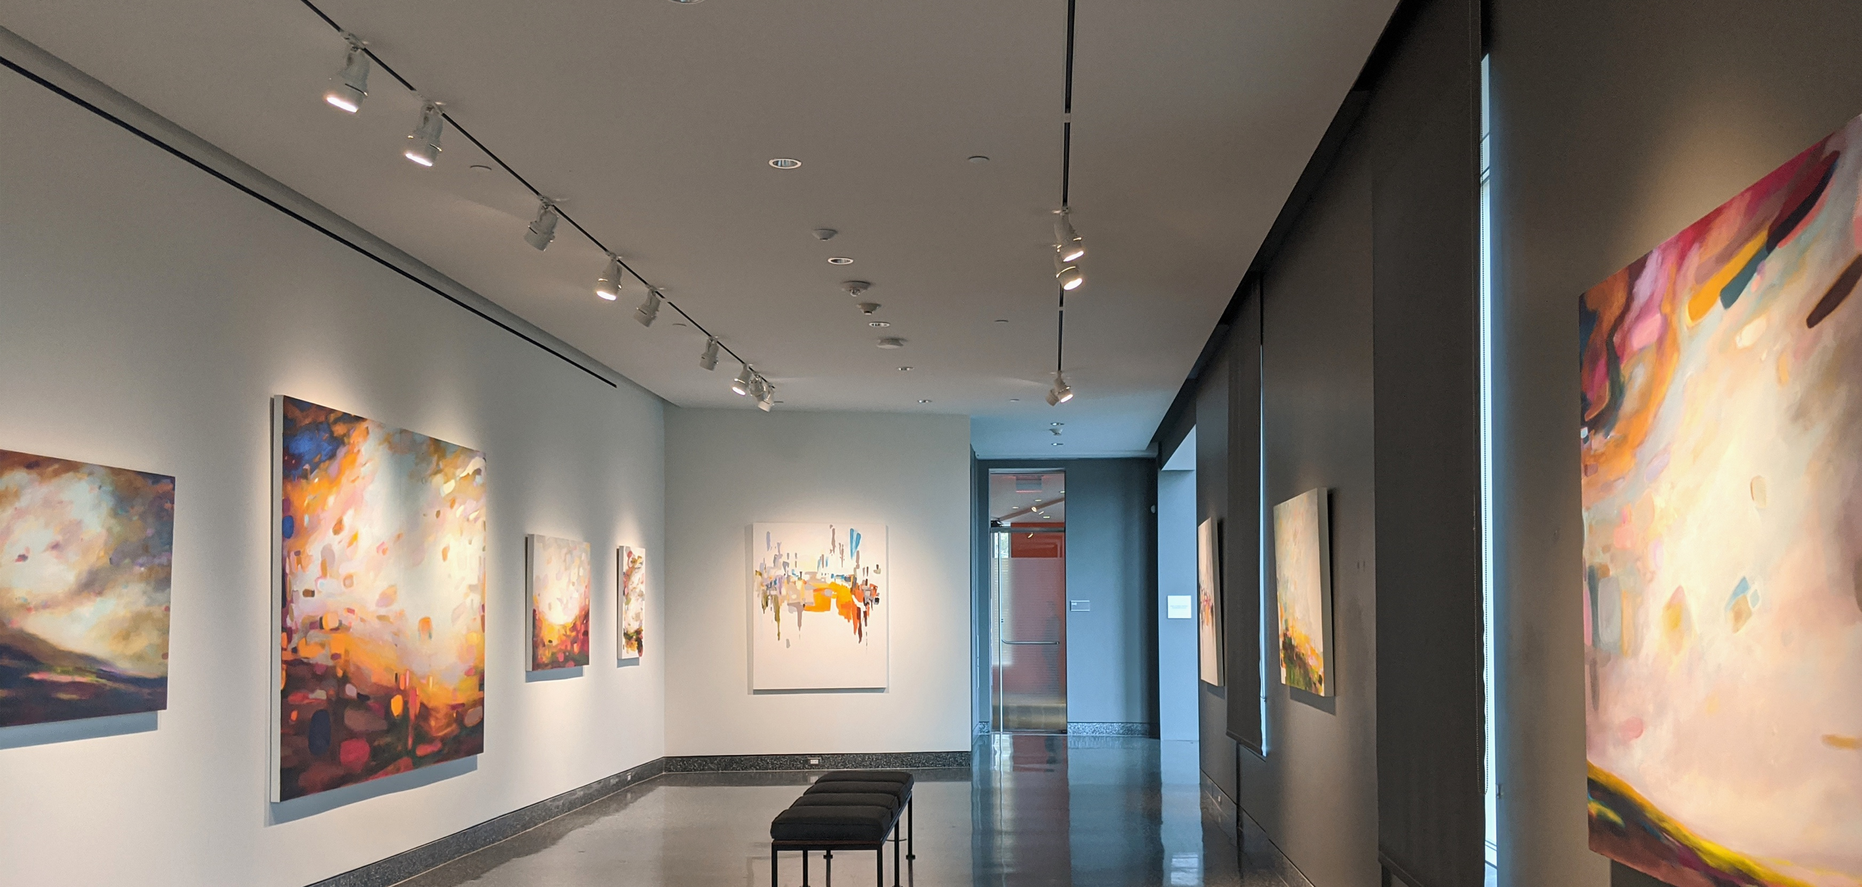
Commissioned Artwork Investment Guide
2024
Nicole Renee Ryan Studio LLC
Nicole Renee Ryan Studio LLC
Nicole@artbynicolerenee.com
Mercer, PA 16137
724-301-4846
www.nicolereneeryan.com

Slide 2
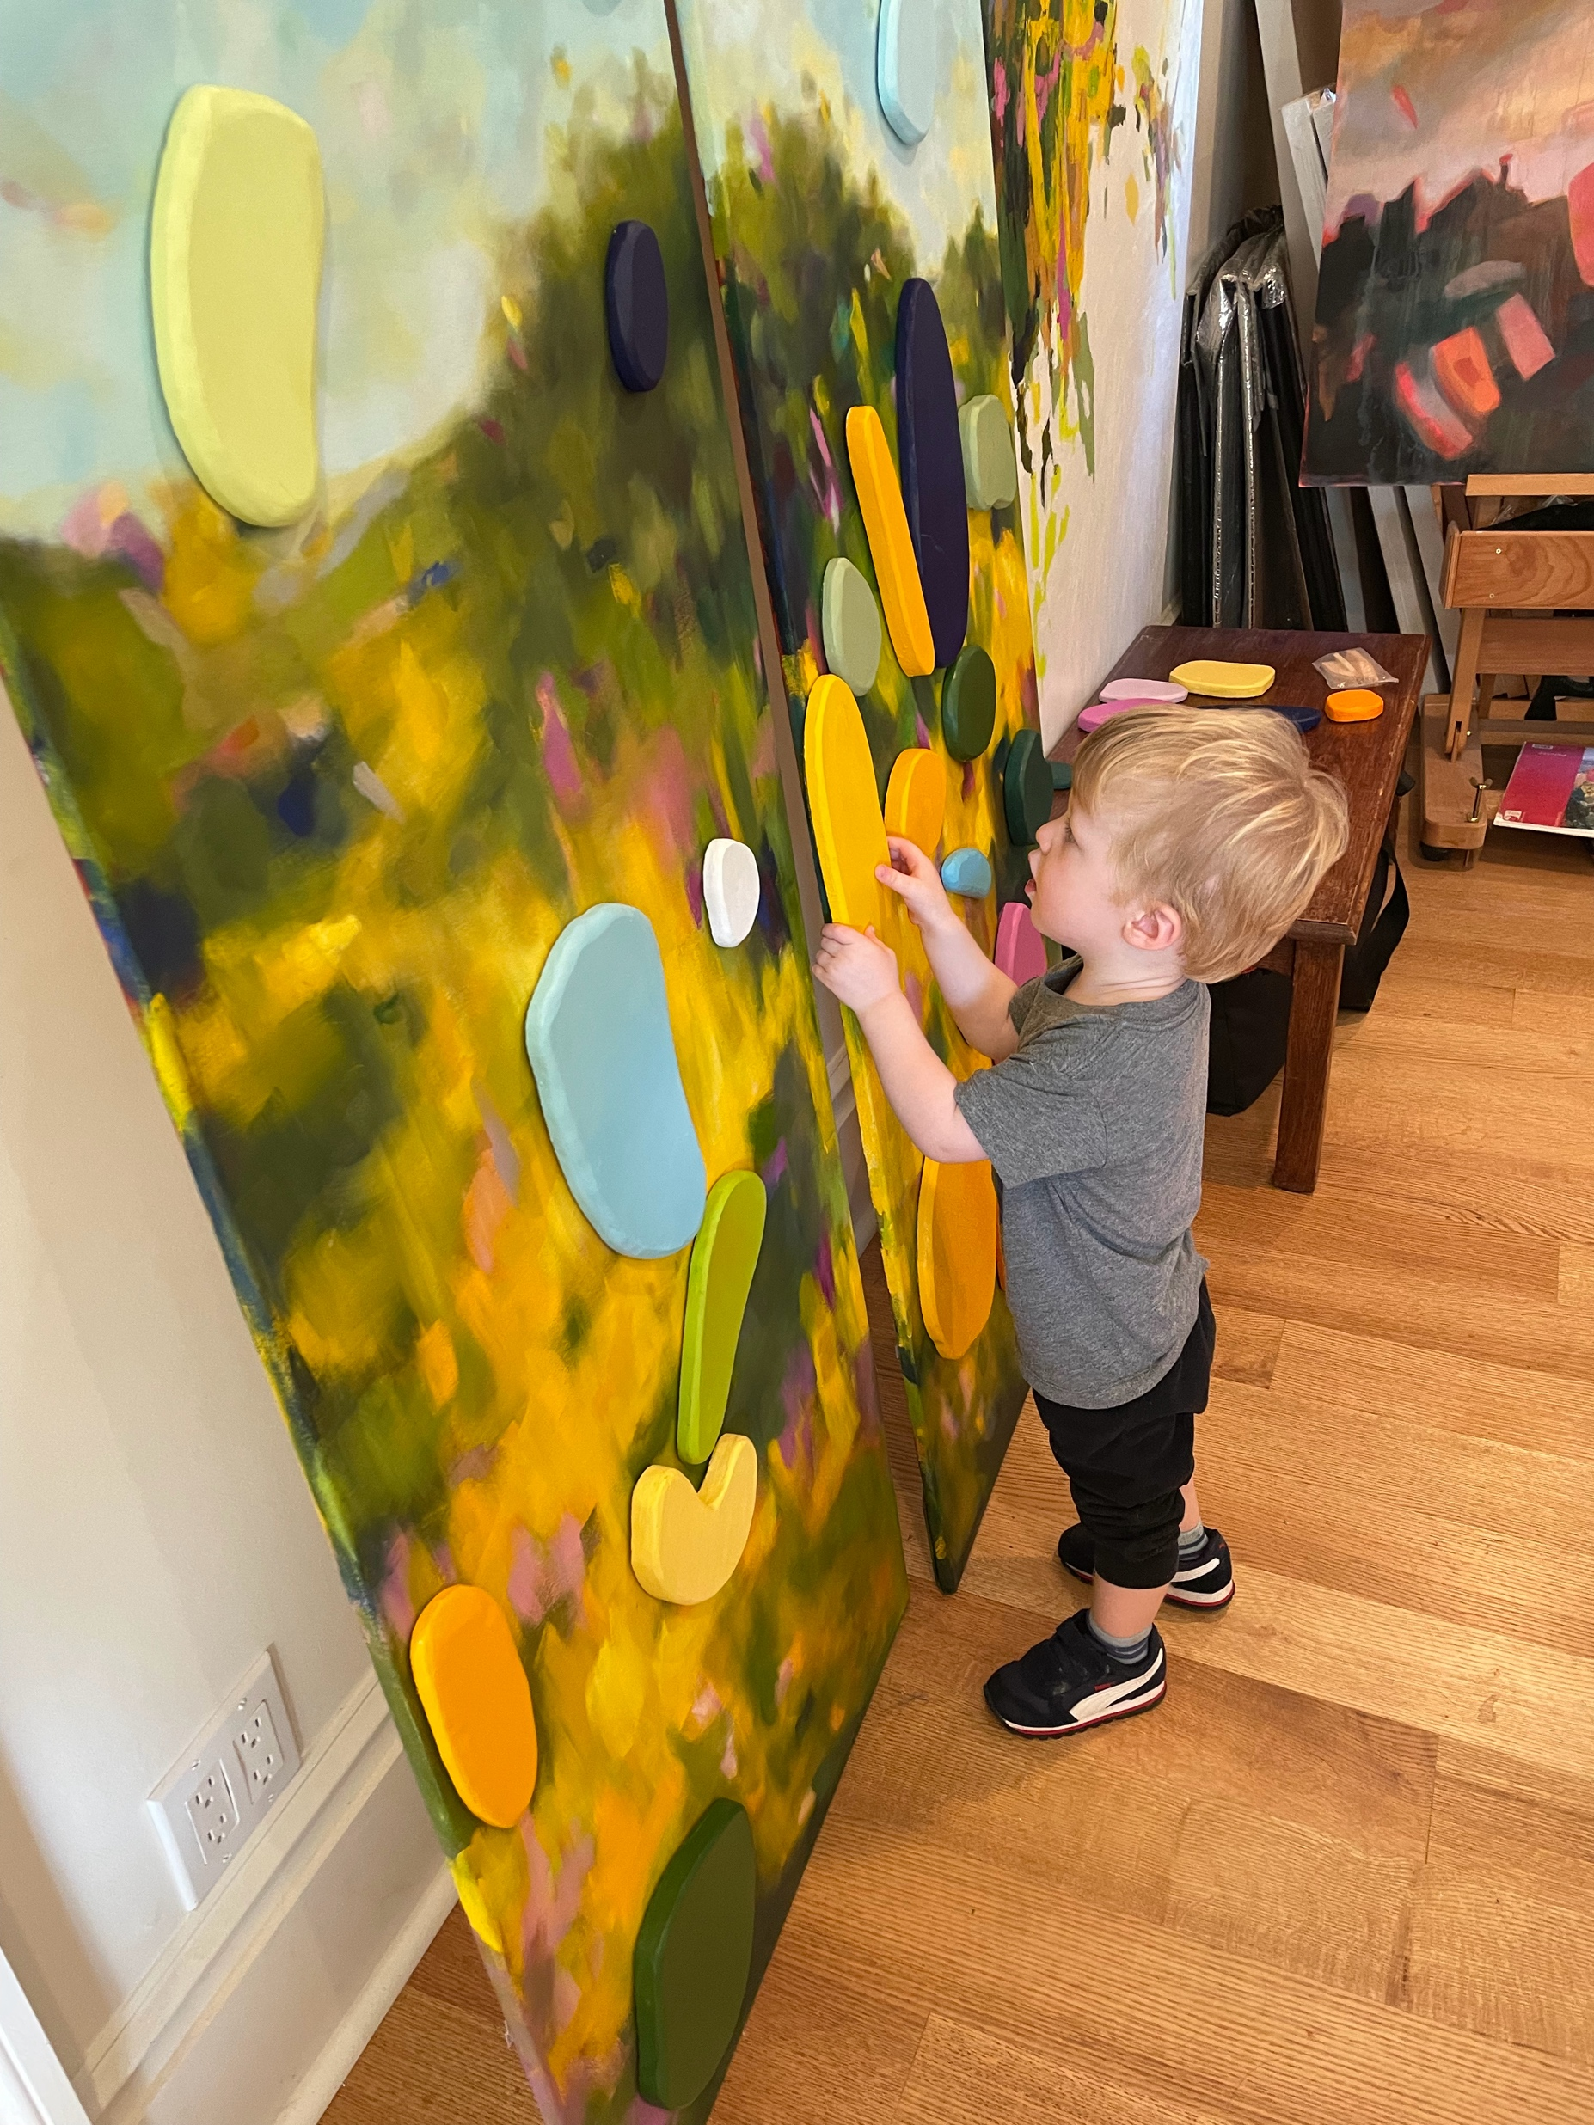
This Commission investment guide will help you learn more about my design process to see why I am different and to help you decide if I might be the right fit for your project.
Commissioning art is an investment. It’s an emotional investment as much as a financial one; an intimate process. It’s no wonder that many of my clients become friends as a result of our collaboration. And, like any relationship, it takes time to build trust and understand how we can best work together.
This guide is the first step in that process. I’ve created it so you can learn more about how I work, how I think, and how the process works.
If we’ve left anything out or you still have questions after reading through it, please reach out, I am here to help!
Sincerely,
Nicole Renee Ryan

Slide 3
About Nicole Renee Ryan Studio LLC
Hello…
I create Imagined Spaces and Misremembered Places.
I specialize in painting worlds that feel both strange and familiar. Escapism is common in fiction, and I want to create that same sense with this artwork. I like to create spaces in which the landscapes seem to be their own active subject, moving, playing, dancing.
My work has been exhibited in:
Westmoreland Museum of American Art - Solo show
Southern Alleghenies Museum of Art
Architectural Digest Design Show – NYC
Aqua Art Miami during Art Basel - Miami
Featured Collections
Allegheny Country Club
The Benter Foundation
PNC Bank
Frick Innovations Center

Slide 4
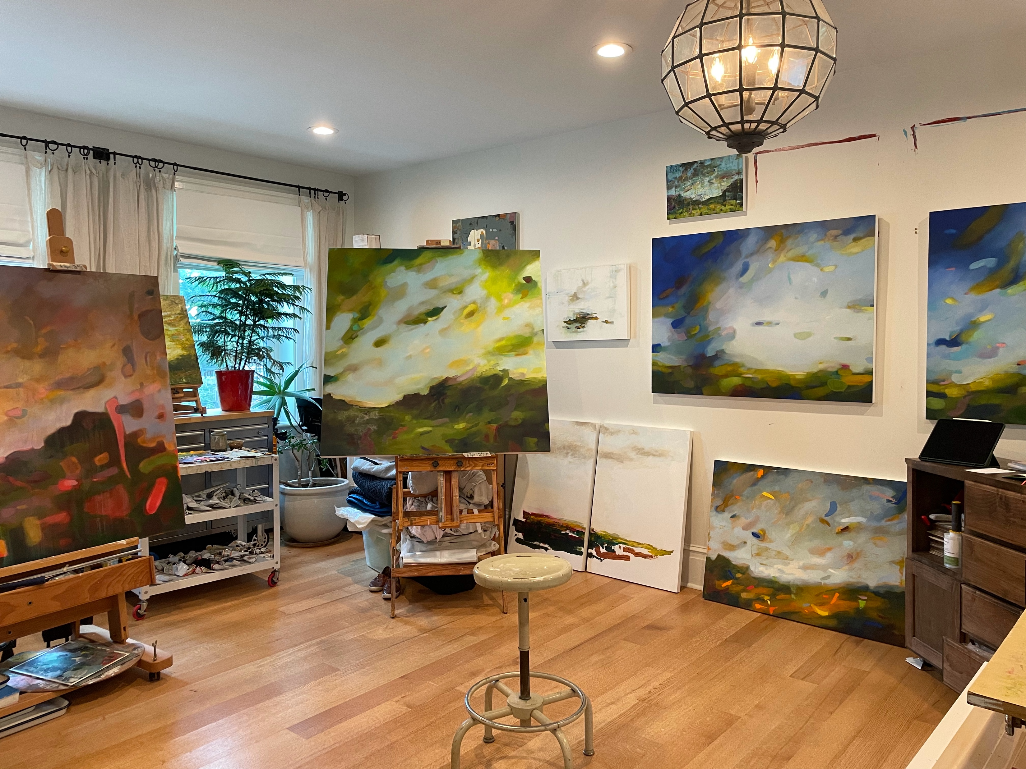
Inside Nicole Renee Ryan’s home studio. Things are always moving around, and there are usually an average of 10 works in progress at all times.

Slide 5
How to Commission a Nicole Renee Ryan Painting
We start by having a conversation around size, series (or similar works you like me to base your painting on), and some general colors and other notes. Once we determine this, 50% down is due to confirm the start of the commission.
I then start 2 paintings the same size that fit the requirements of the commission so I can go in slightly different directions at the same time and you, the client, has choice at the end. I keep the client appraised of progress with pictures.
Once everyone is happy with the painting and agree that it is finished, then the project is complete. You get to pick which painting you want as your commissioned piece. I will keep the other one to sell or exhibit.
Painting dries (usually within 2 weeks of being finished). The painting will get named (and you can help) and photographed. I will deliver or ship depending on location.

Slide 6
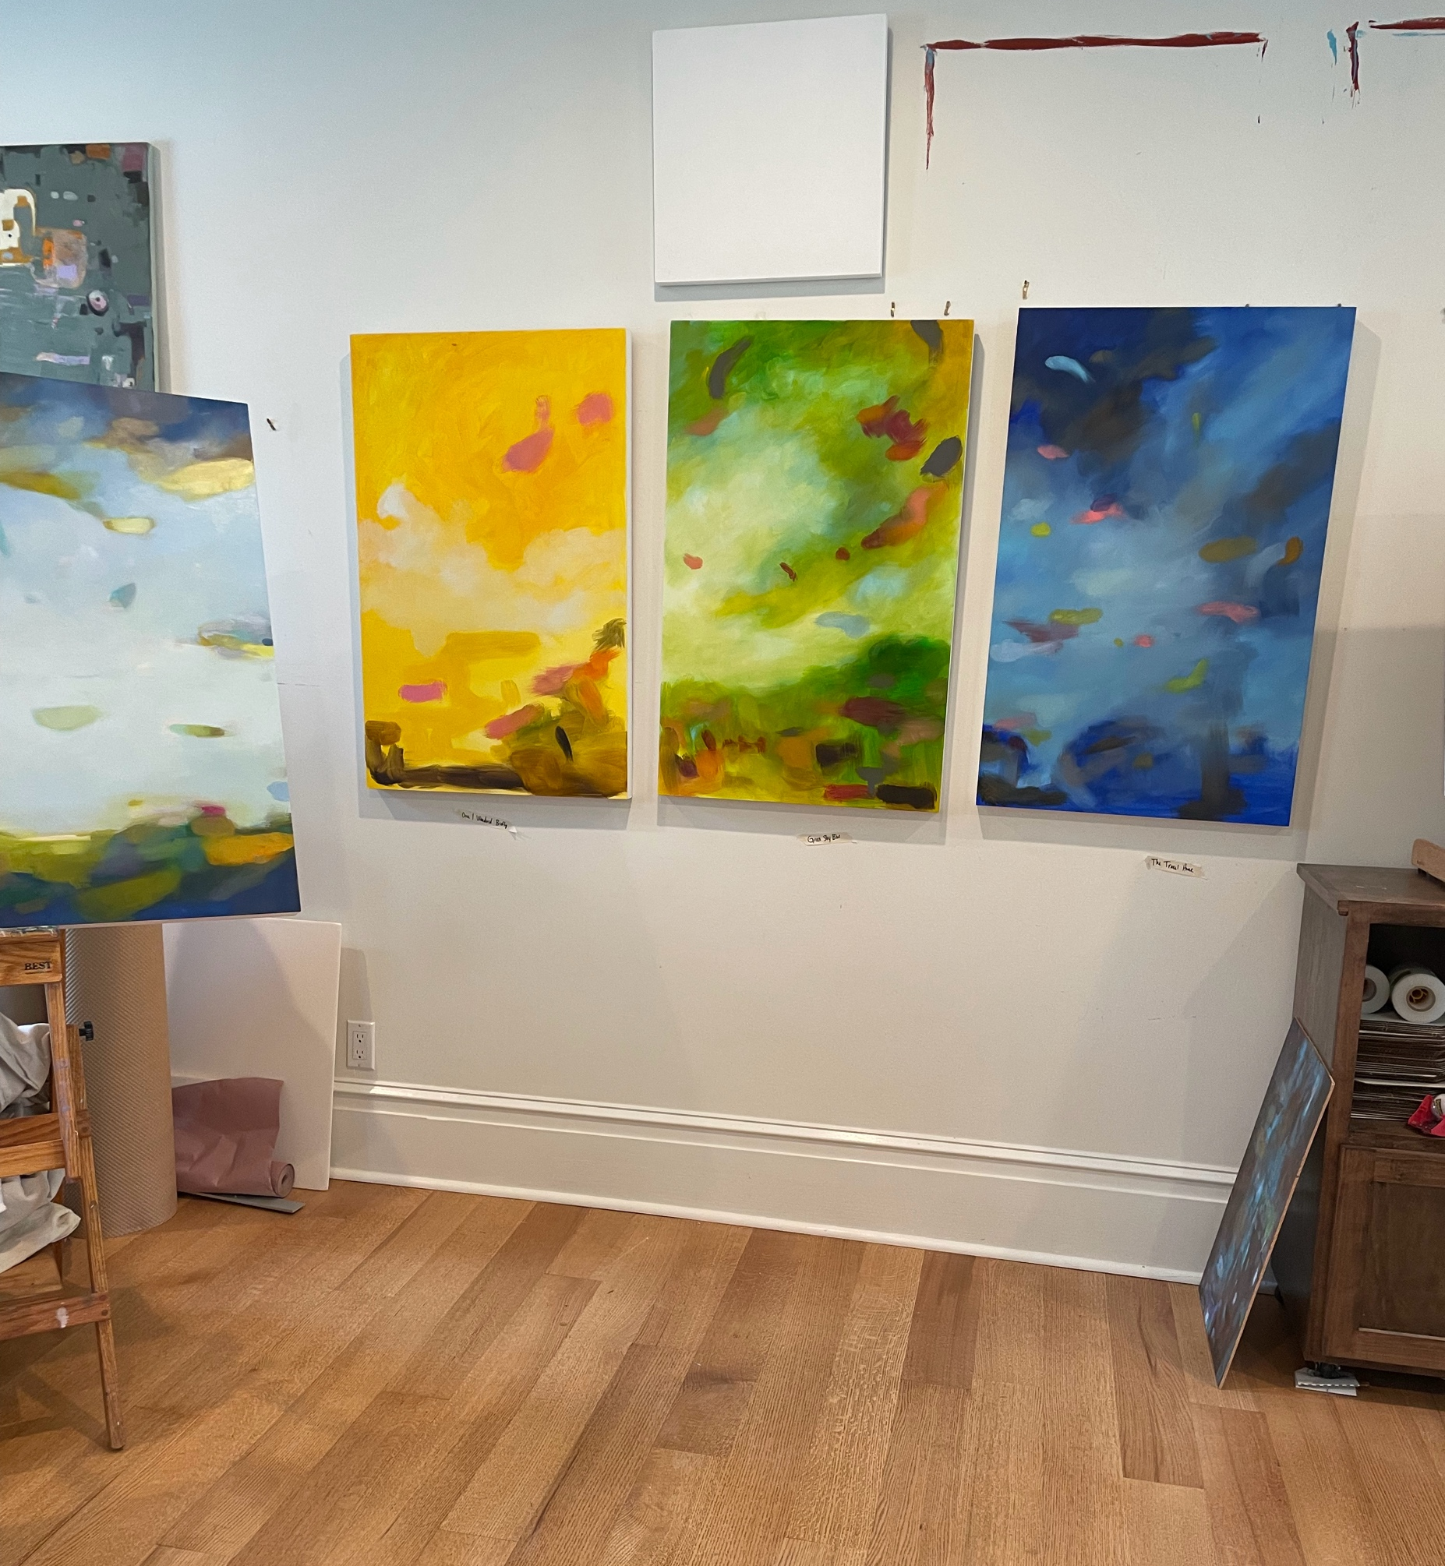
Process Notes
Things progress together in the studio. Here you can see three pieces at a similar beginning stage of development.
I bounce around from series to series. Here you can see me working on a piece from my Remnant series (white blocky) and from my Confetti series (moody blues and browns).

Slide 7
Why Commission a painting?
You have very specific size constraints and want to maximize your space.
There was a piece that you fell in love with (or multiple) that is no longer available.
You want to be in the background of the artwork process, to see how the sausage is made.
You want to support a living artist while also ending with story to tell about the process (and the process of making artwork can be messy and change directions many times!) Essentially, you get to sit in the plane and tell me where to go, even as I am the one flying.
The world is strange and mysterious, and you want to lose yourself in a world you helped imagine.

Slide 8
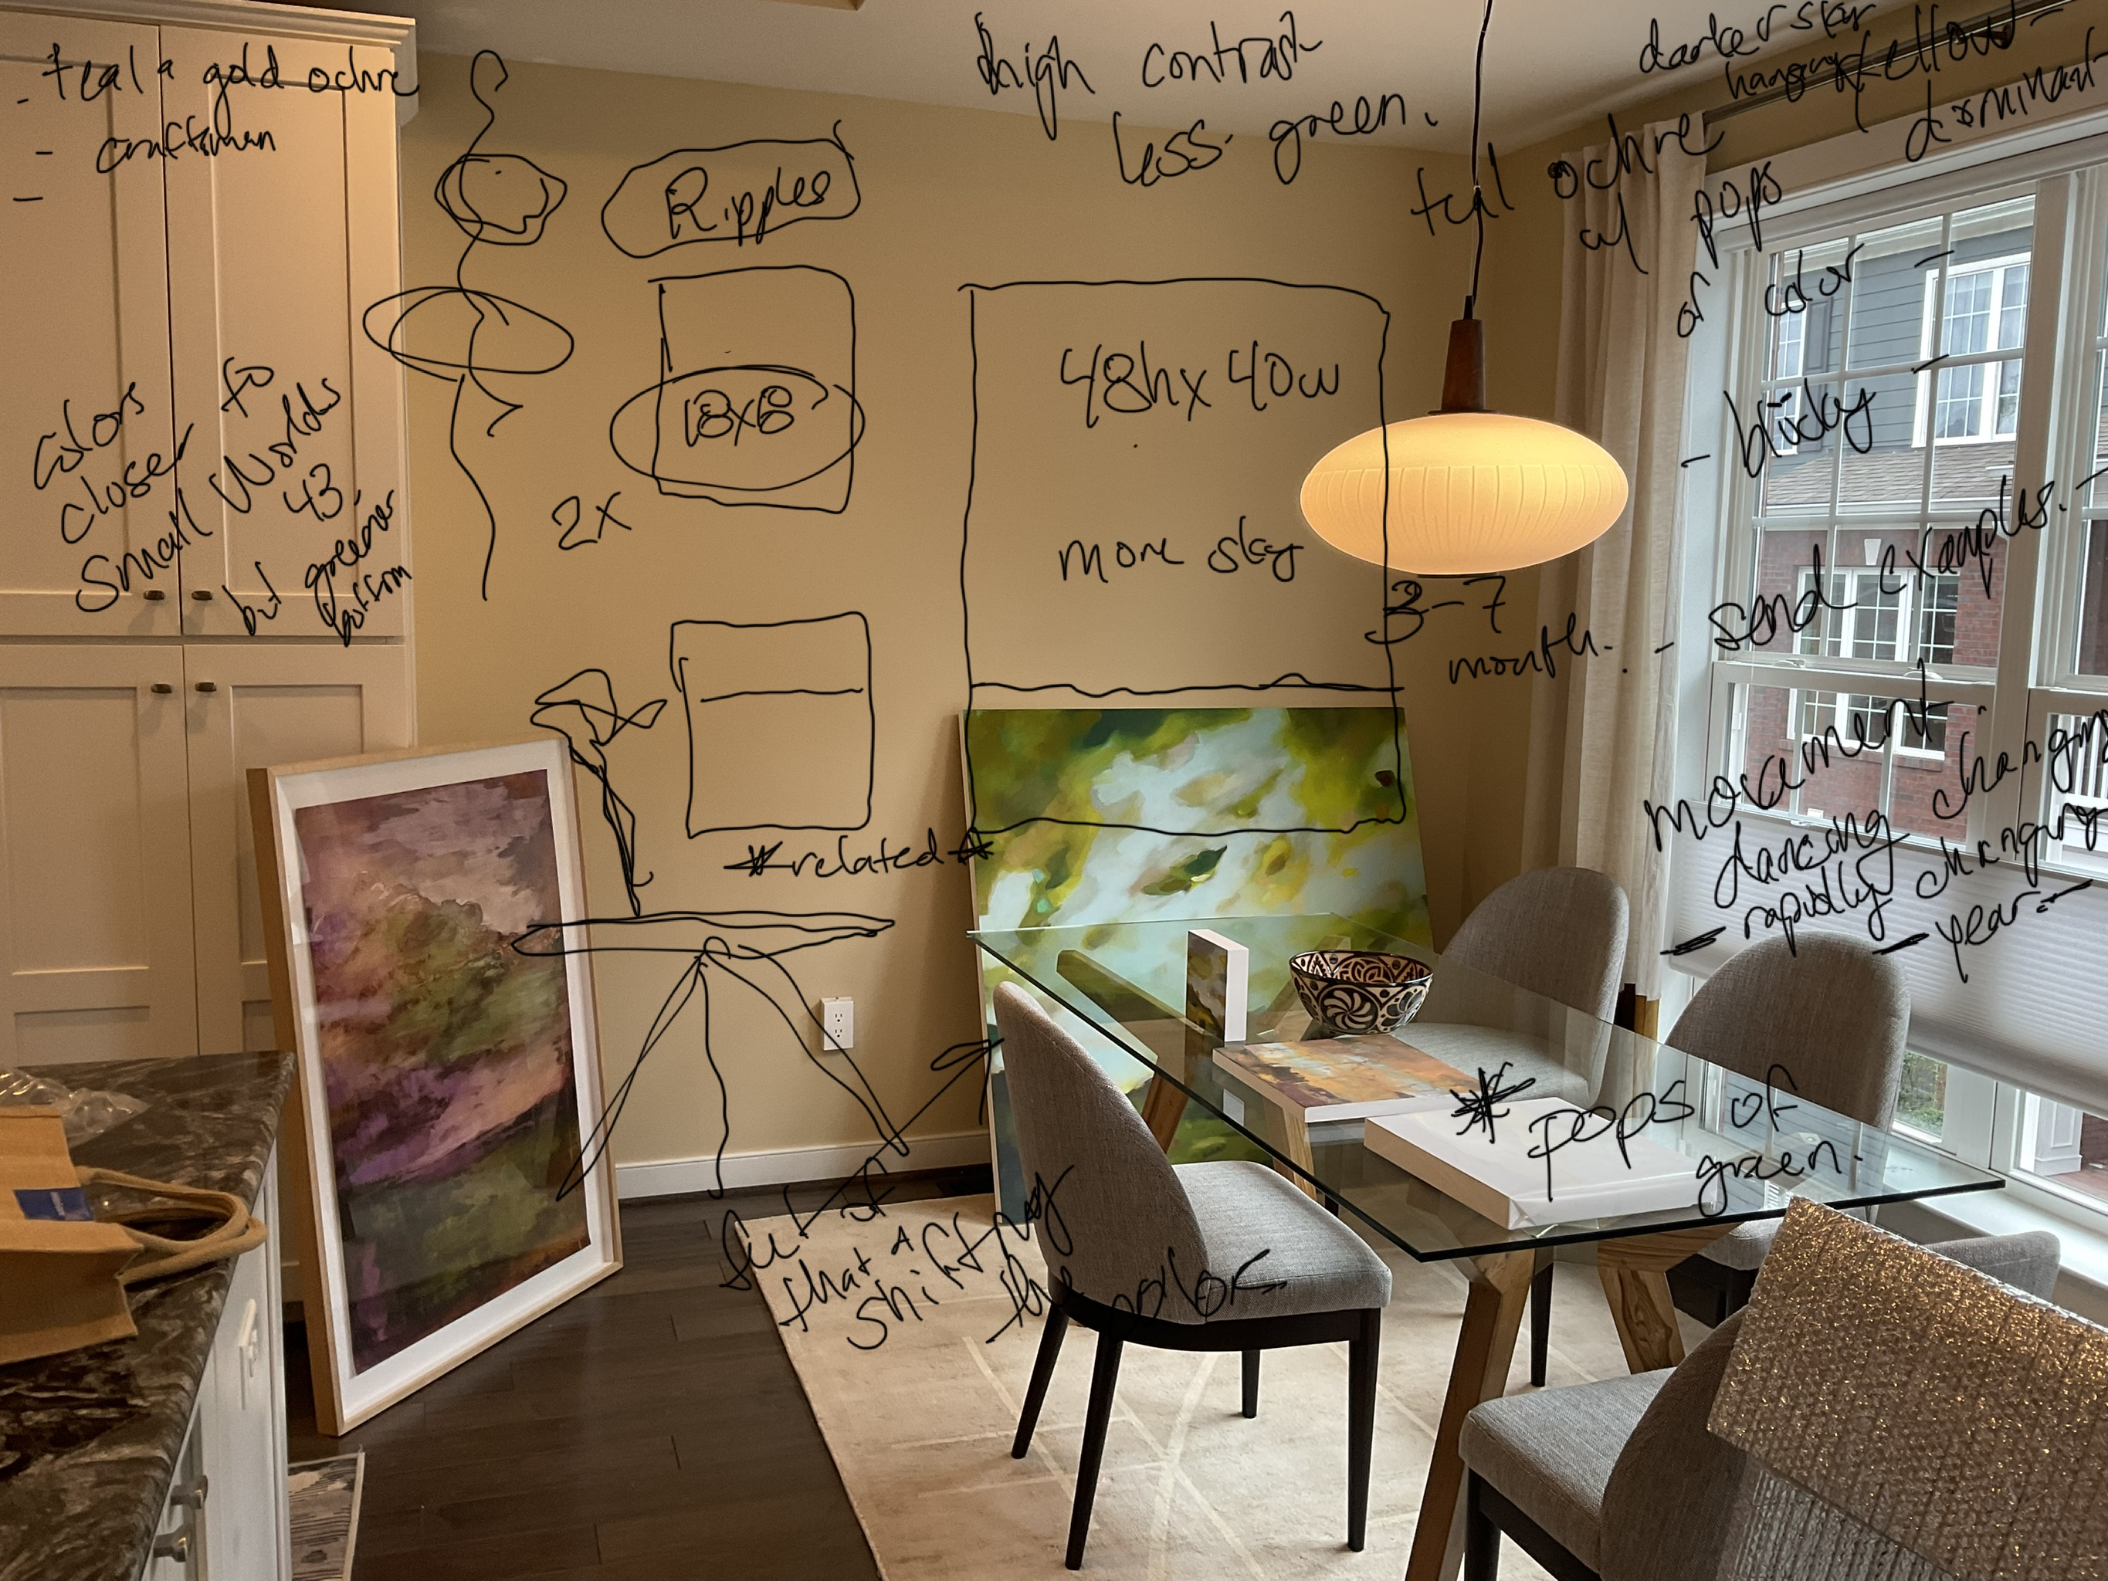
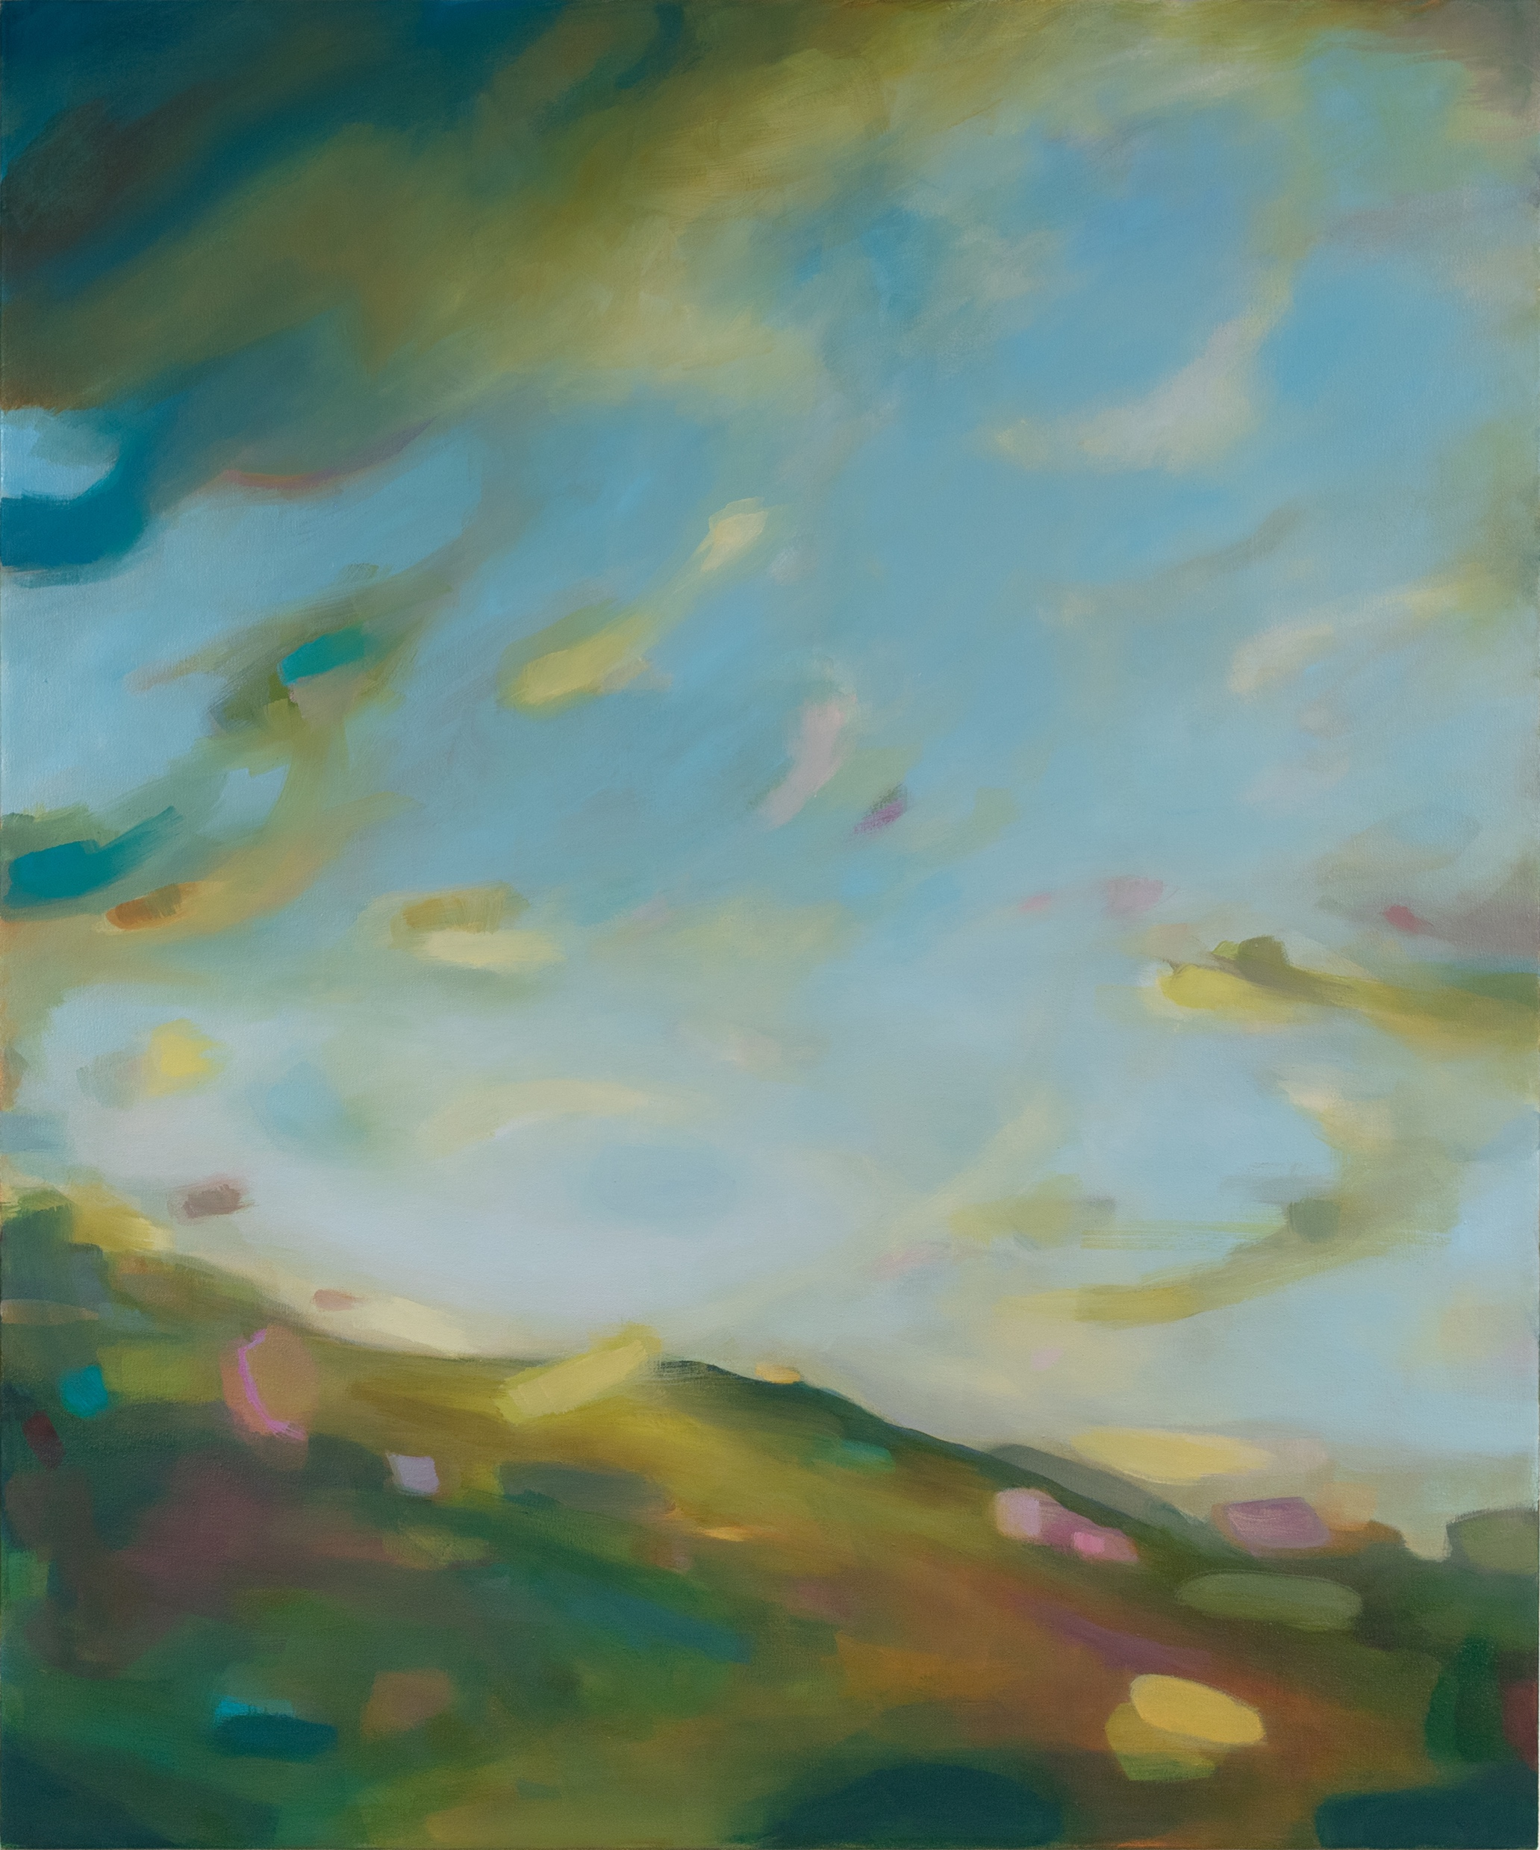
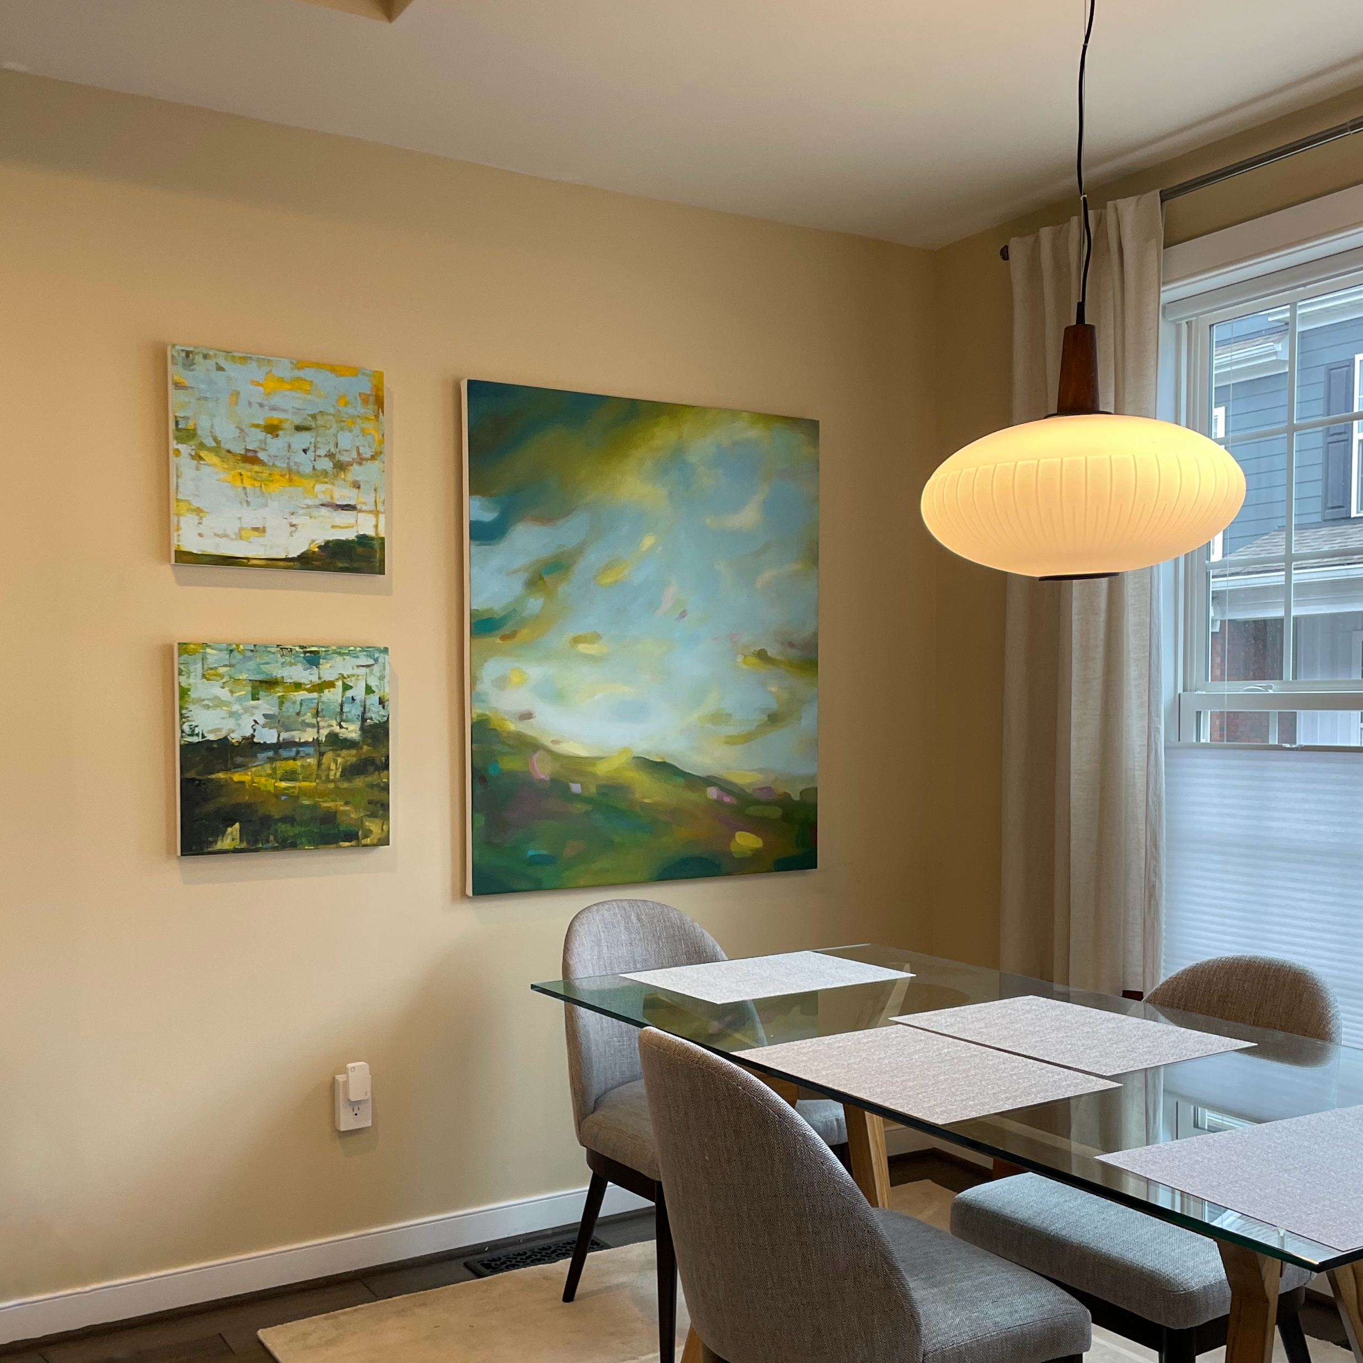
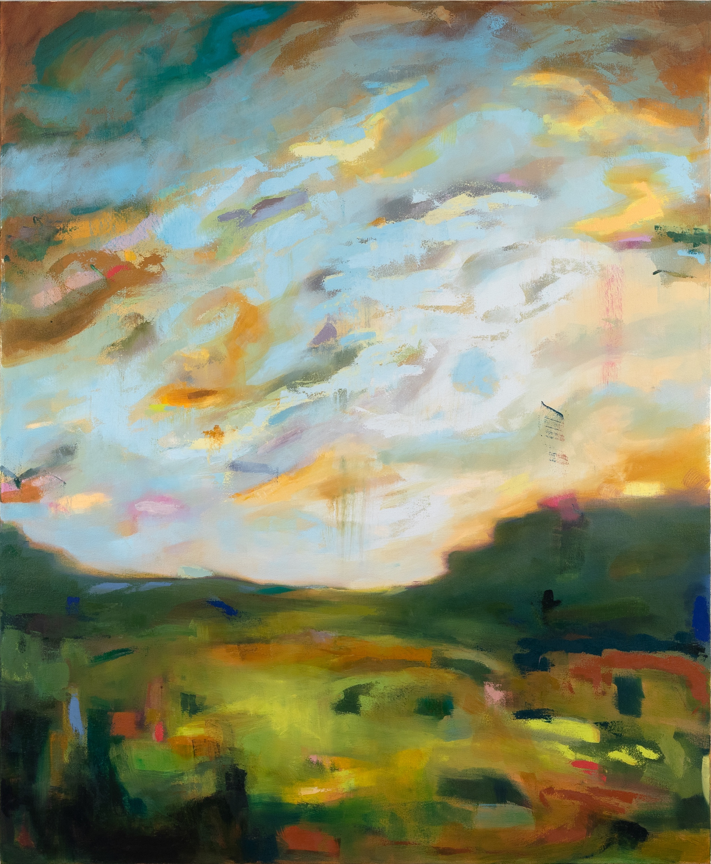
Sewickley Dining Room Commission
Process Image
Other World Behind
For this commission, the client was close enough I could take pieces to her home to get a sense of size, color etc. During our conversation on site, I drew over a photo I took on my ipad. It is very rough, but these are the types of notes I take at the beginning of a project. You can see how we planned layout, size and color in this stage.
The finished trio of commissions.
For clients who live close such as this one, I both delivered the piece in person and hung them on her wall.
The Time Before and After

Slide 9
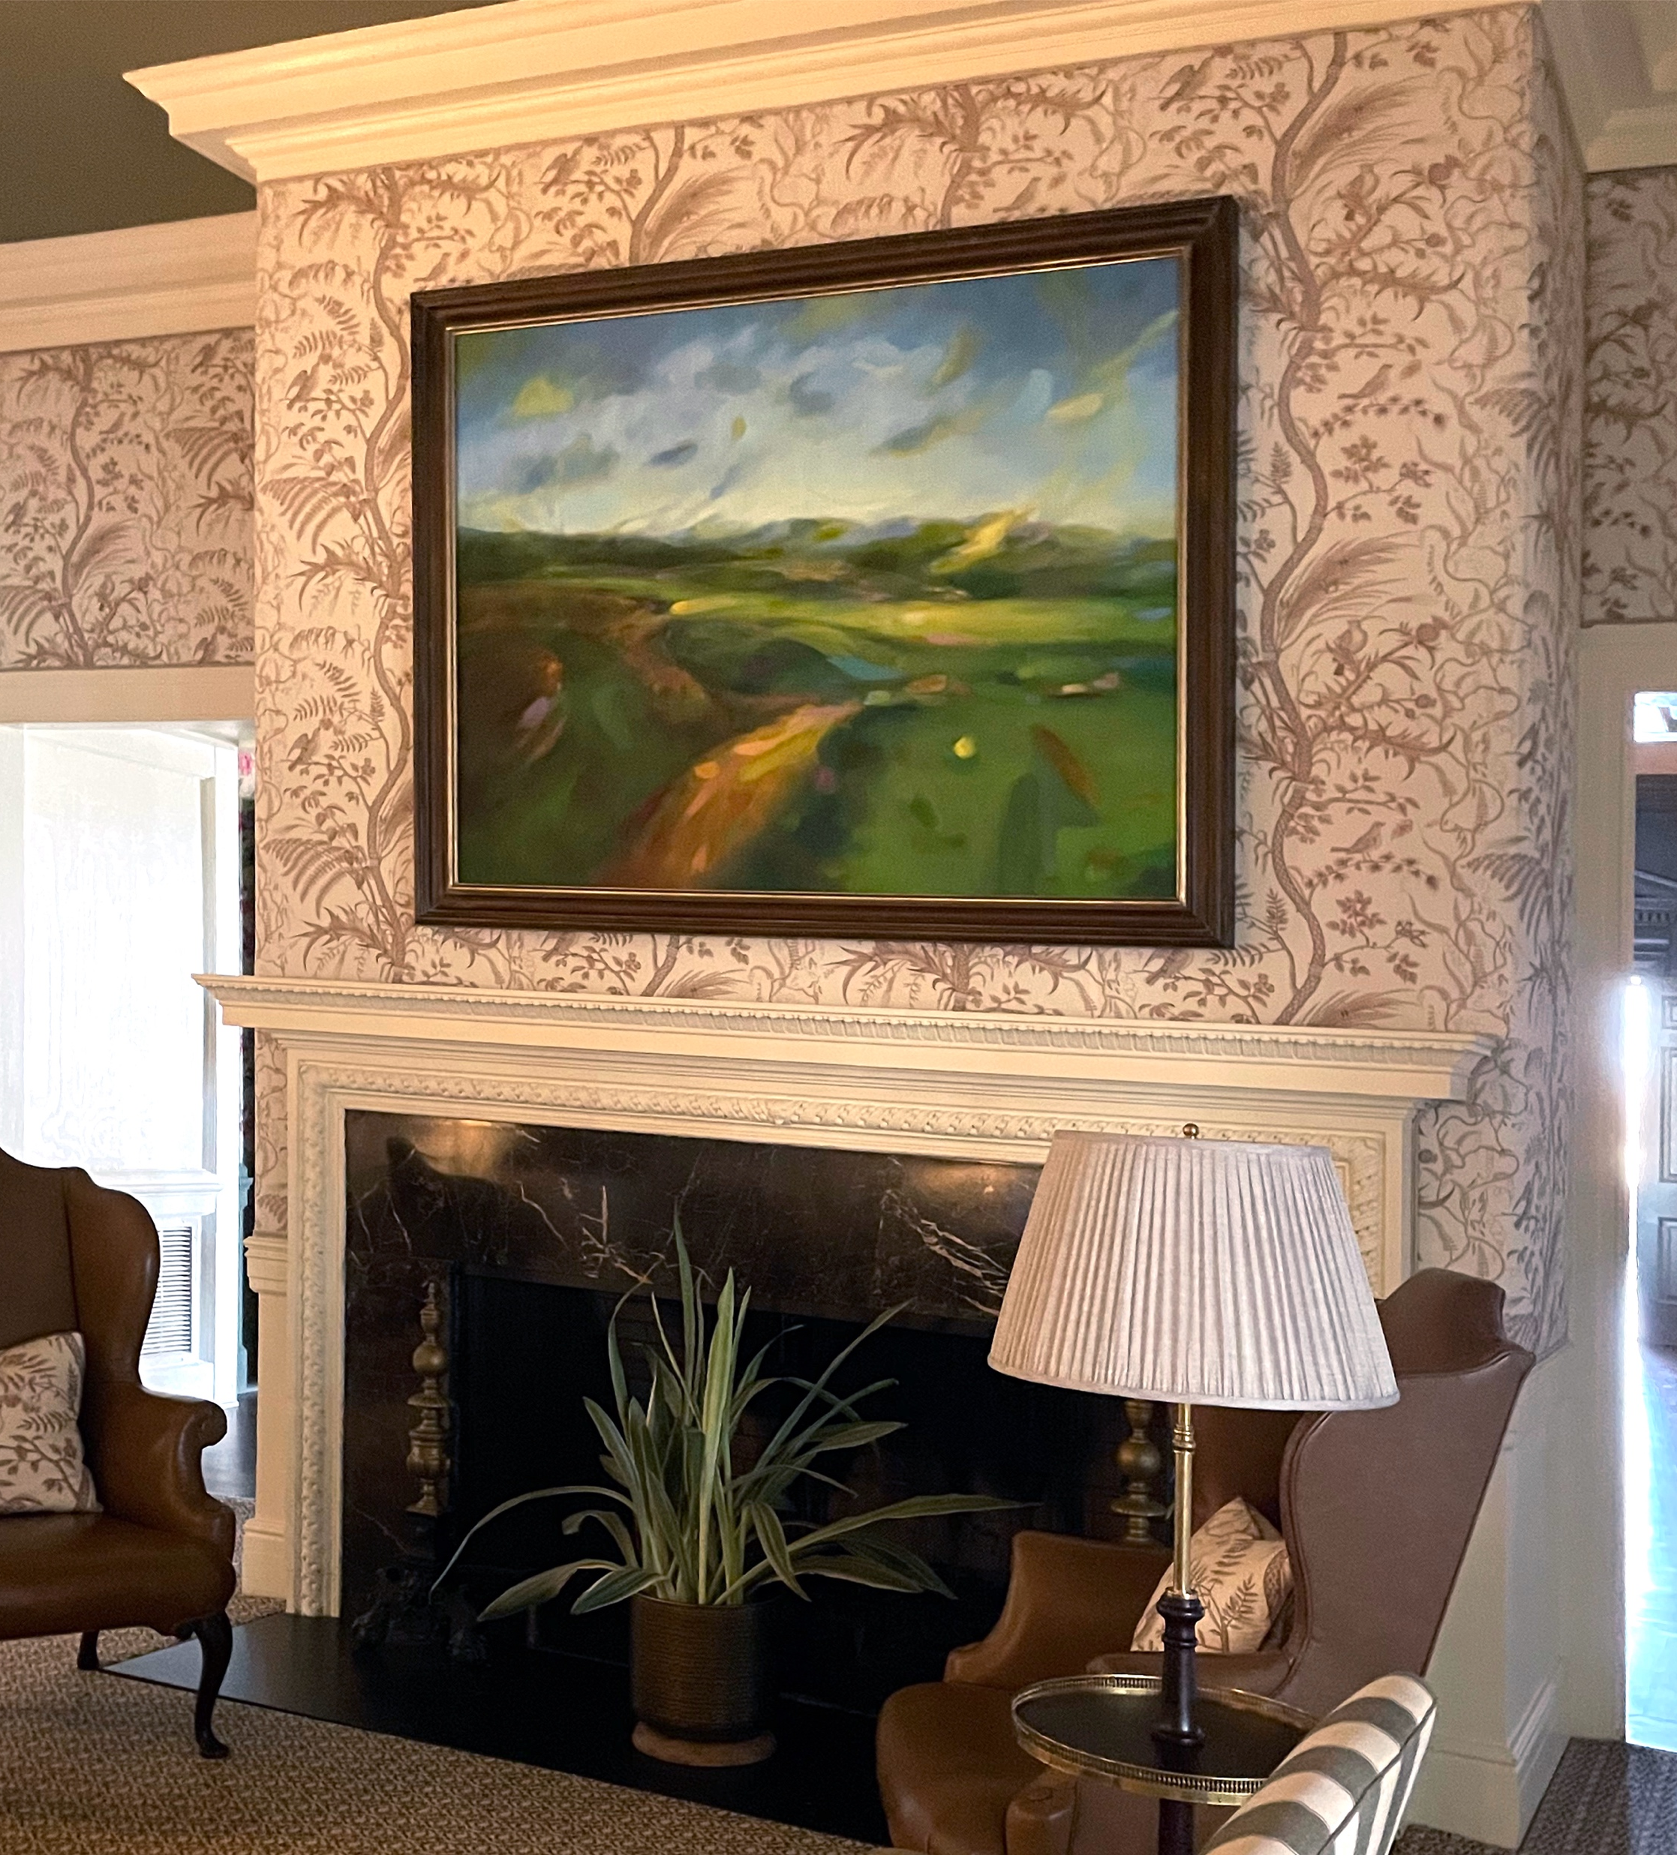
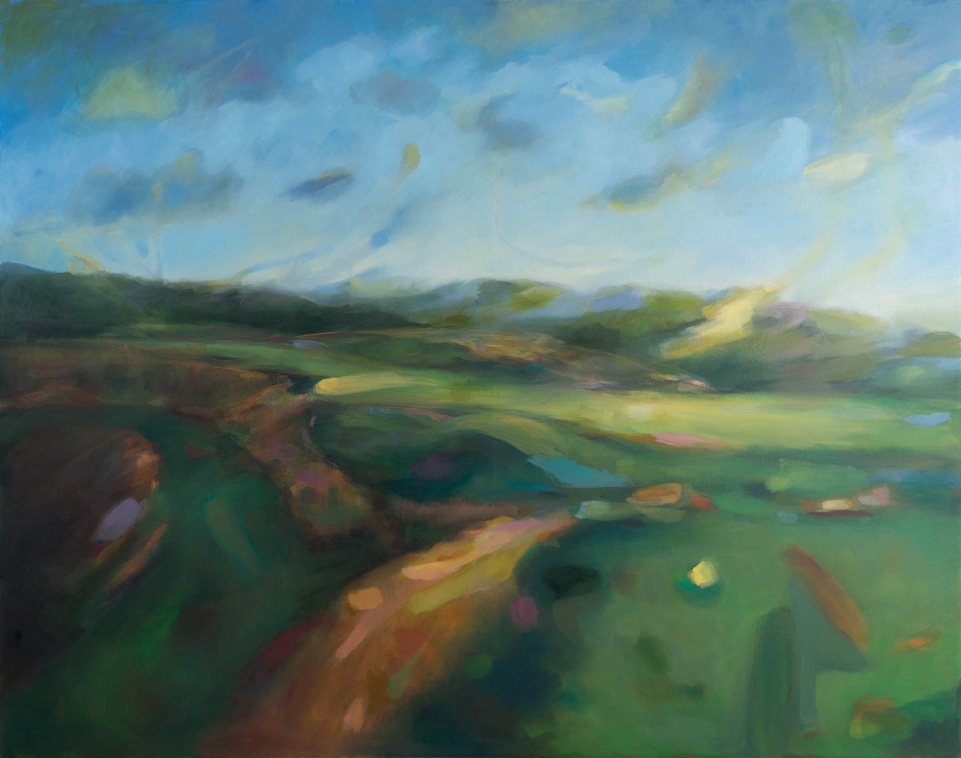
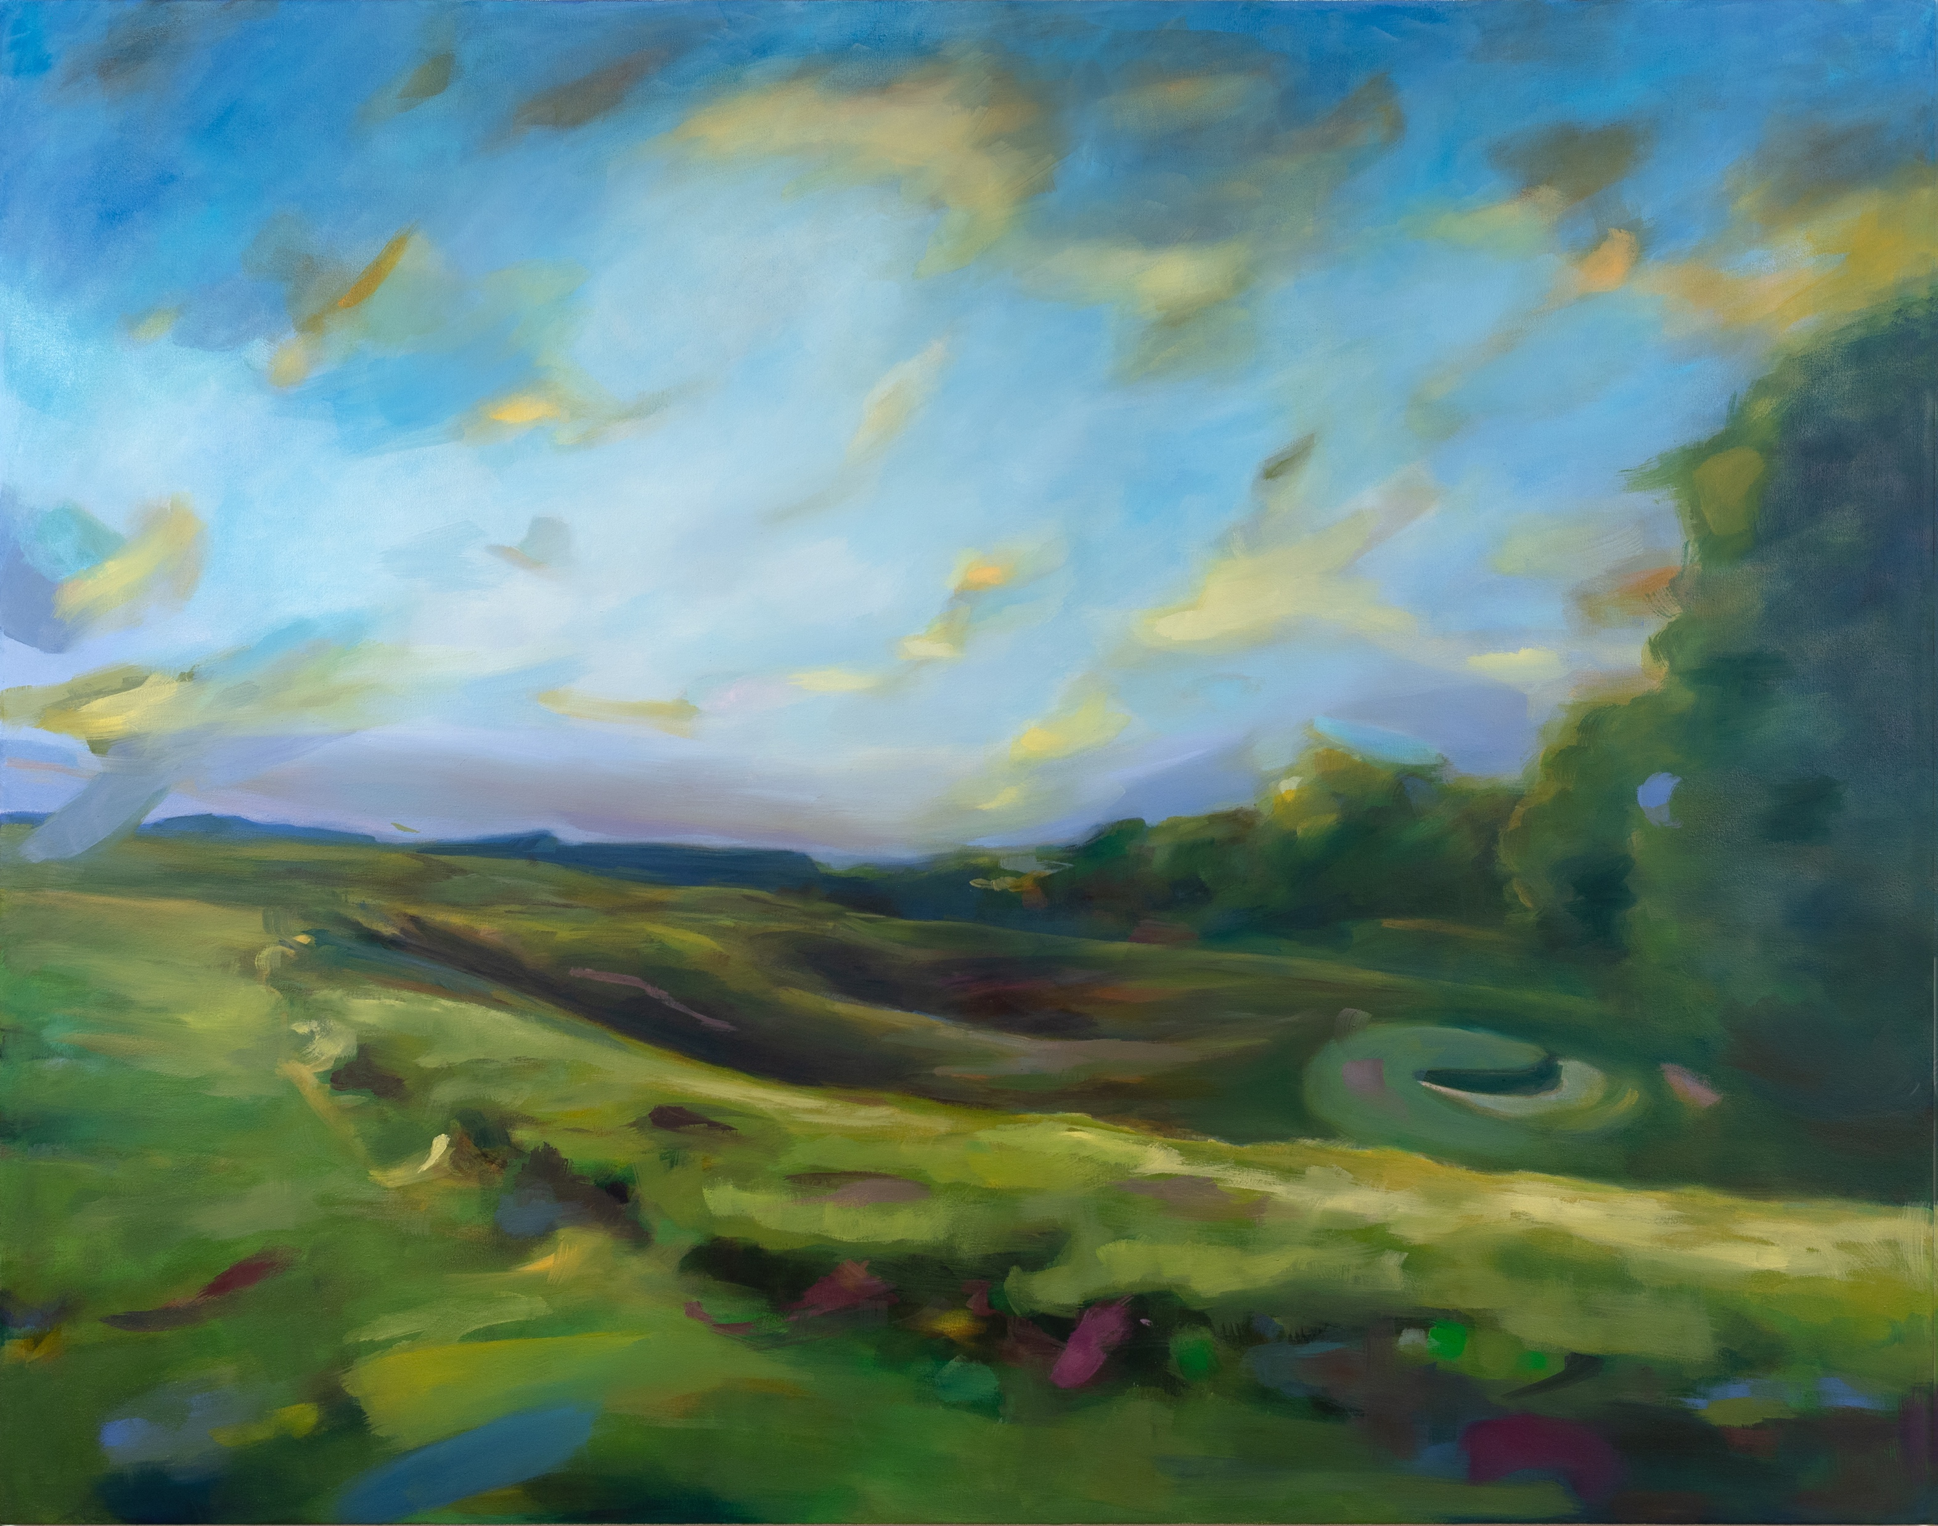
Allegheny Country Club – Painting for Living room renovation.
For these commissions I stayed overnight at the Country Club to witness the sunrise/sunset and use a compilation of these memories to create these two works.
The Far Elsewhere Country
A Hundred Years of Sky

Slide 10
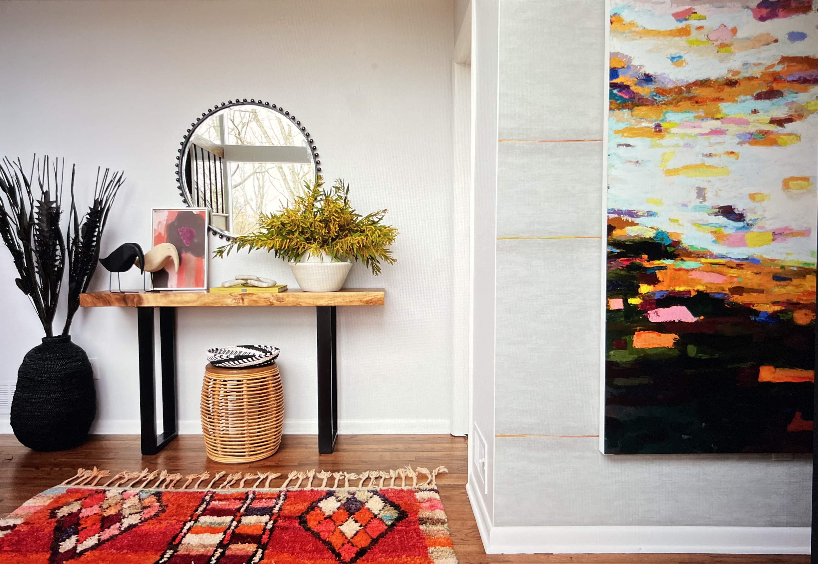
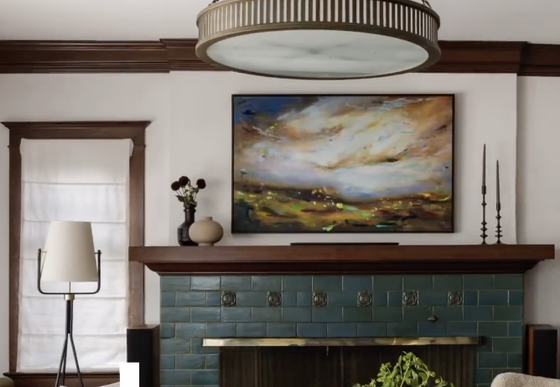
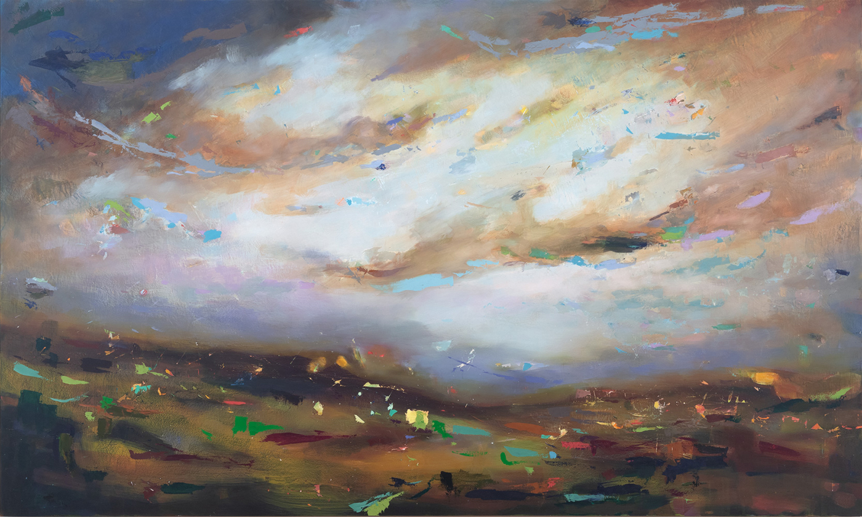
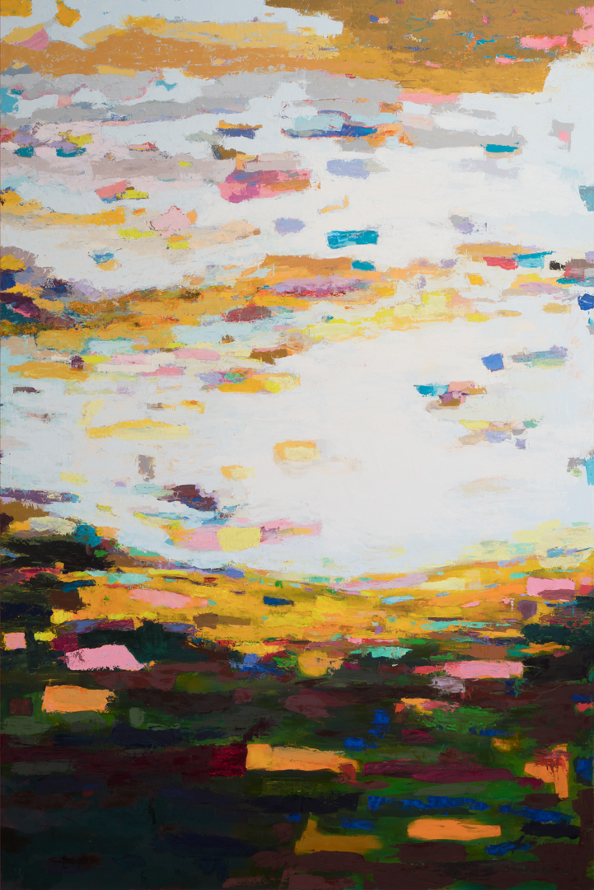
Works in Context
The Sky Fell In Making Us Late
Interior Designer: Betsy Wentz
The Past Rises Up To Meet Me
Interior Designer: Hyrel Mathias
Placed in a home in Seattle, Featured in Luxe Magazine

Slide 11
frequently asked questions
Pricing Commissions
Commission prices are easy to calculate: $3 a square inch rounded to the nearest $100
Minimum cost of a painting is $1000 to start a commission (unless it is multiple small works that add up to at least $1000 which is more than fine)
This cost is the same whether the work is in oil, acrylic or watercolor and does not include costs to frame, the piece comes ready to hang as is.
Common size and price examples (but certainly not limited to)
18x18” $1000
24x36” $2600
36x36” $3900
36x48” $5200
48x48” $6900
48x60” $8500

Slide 12
Typical Project Timeline
 | January | February | March | April | May | June
Predesign / Determine scope of commission
Get supplies / Prep panels
Paint / Give progress updates
Get final approval / Let painting dry
Deliver / Ship painting
2 weeks
4 weeks
3 months
2 weeks
2 weeks

Slide 13
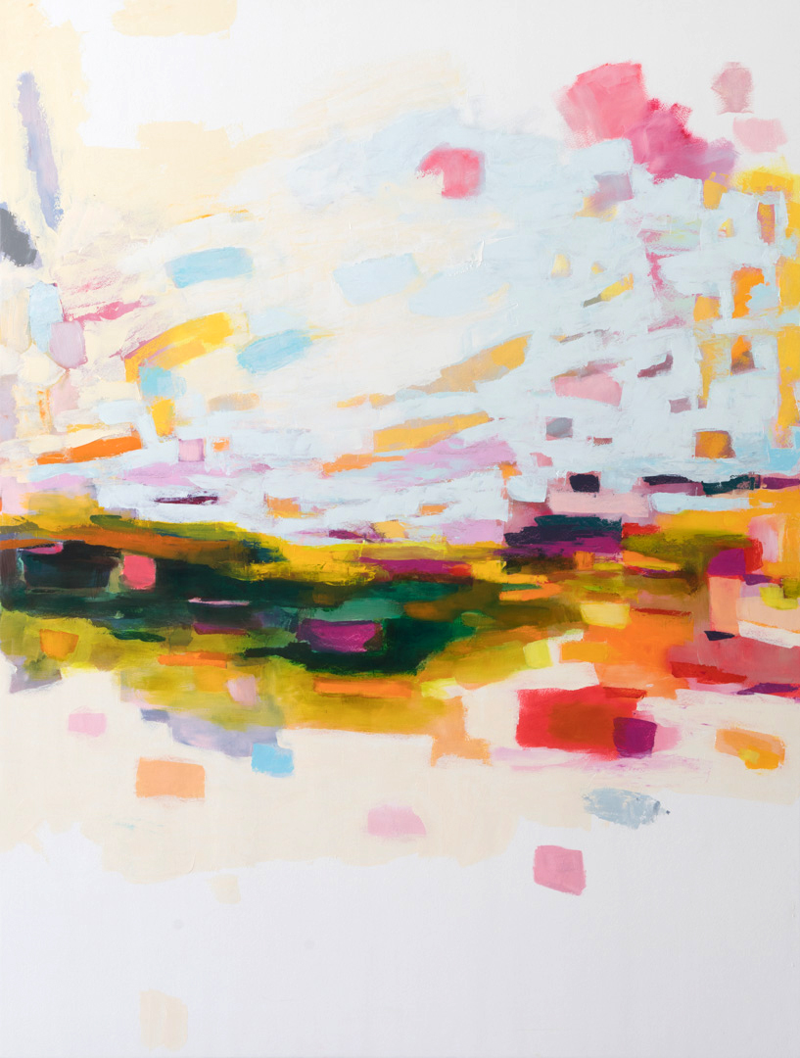
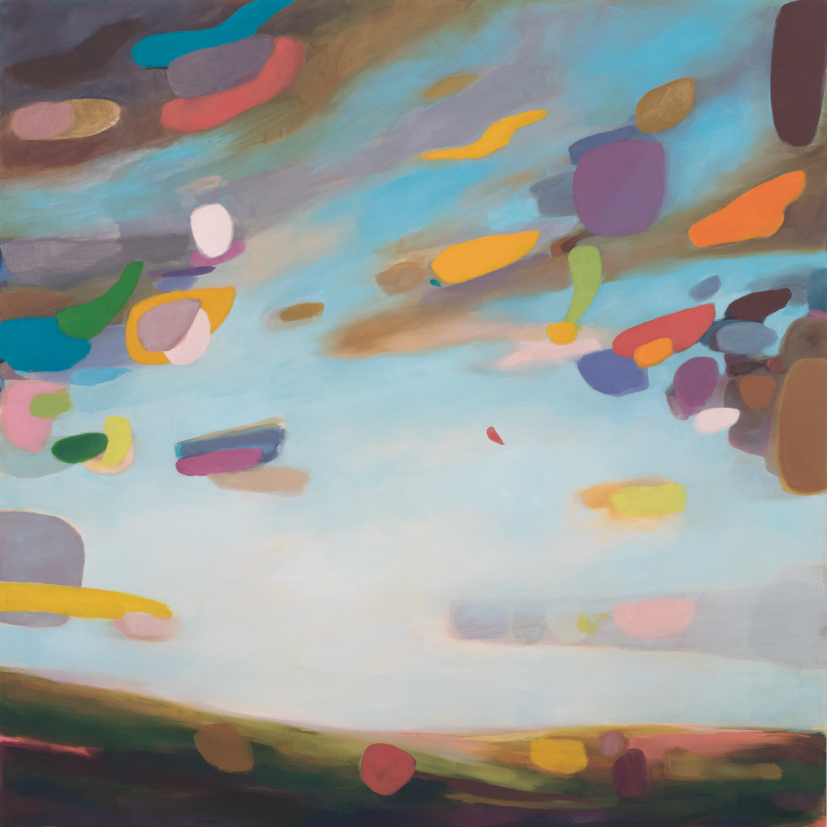
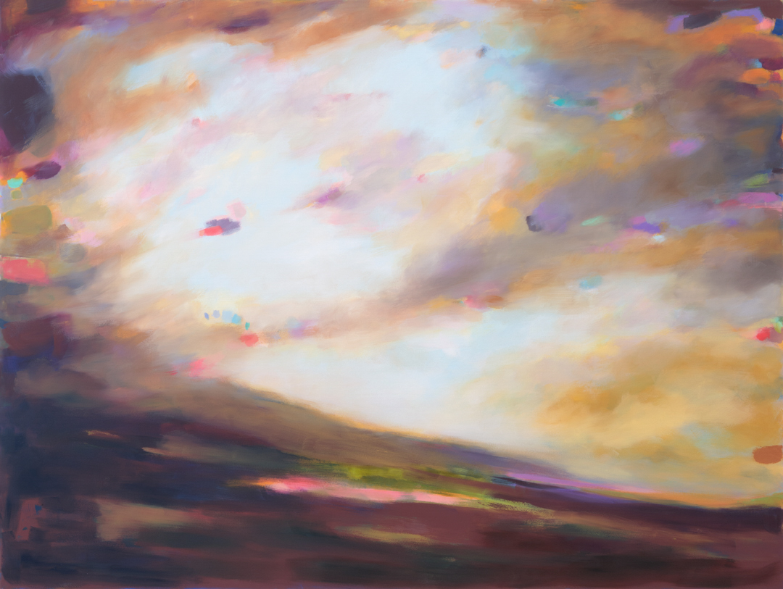
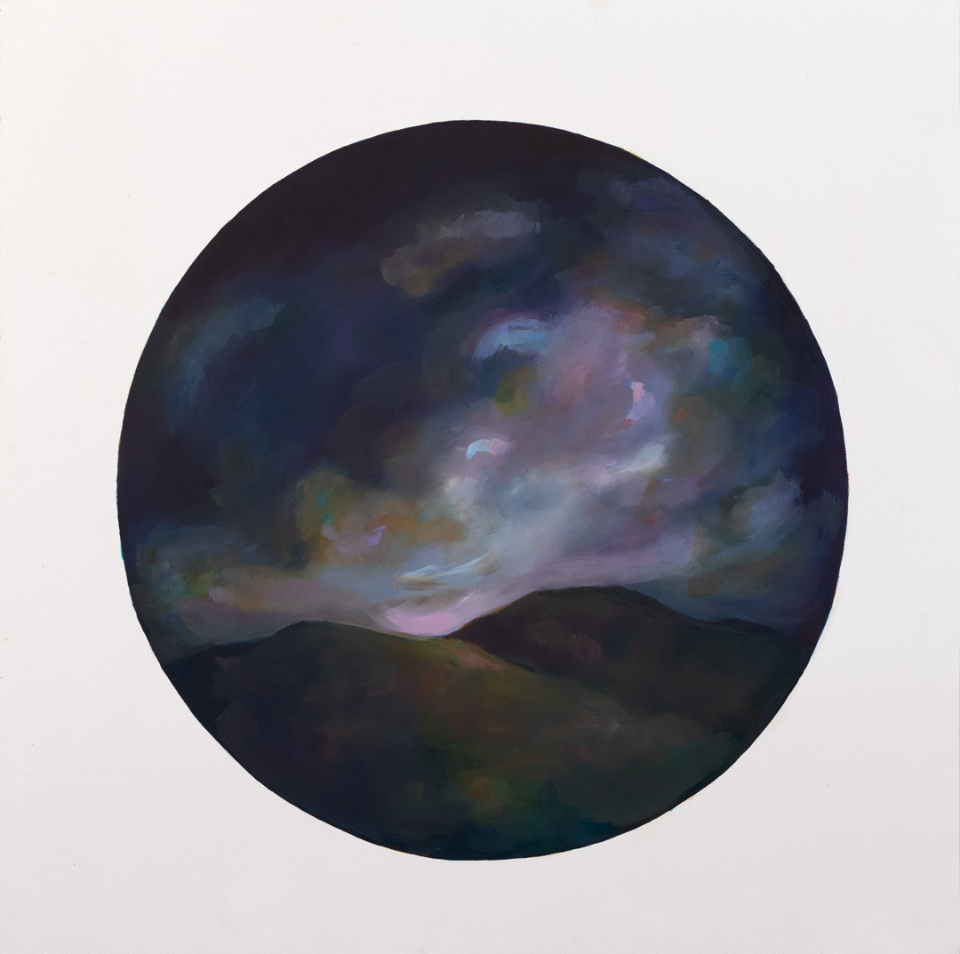
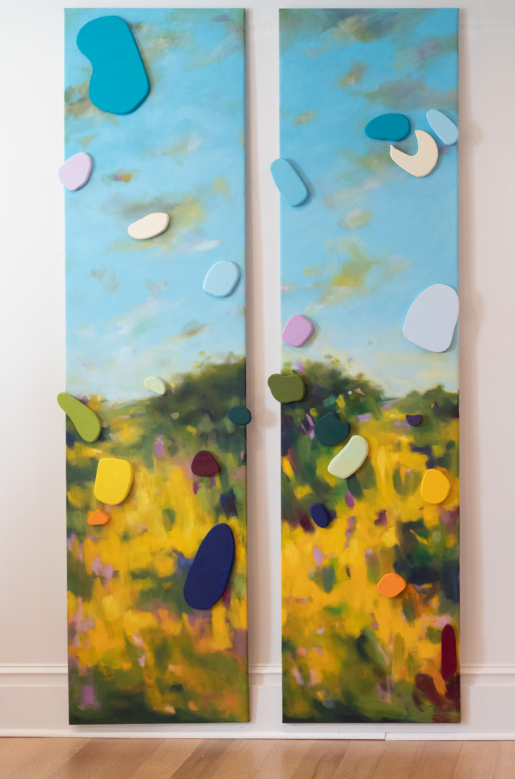
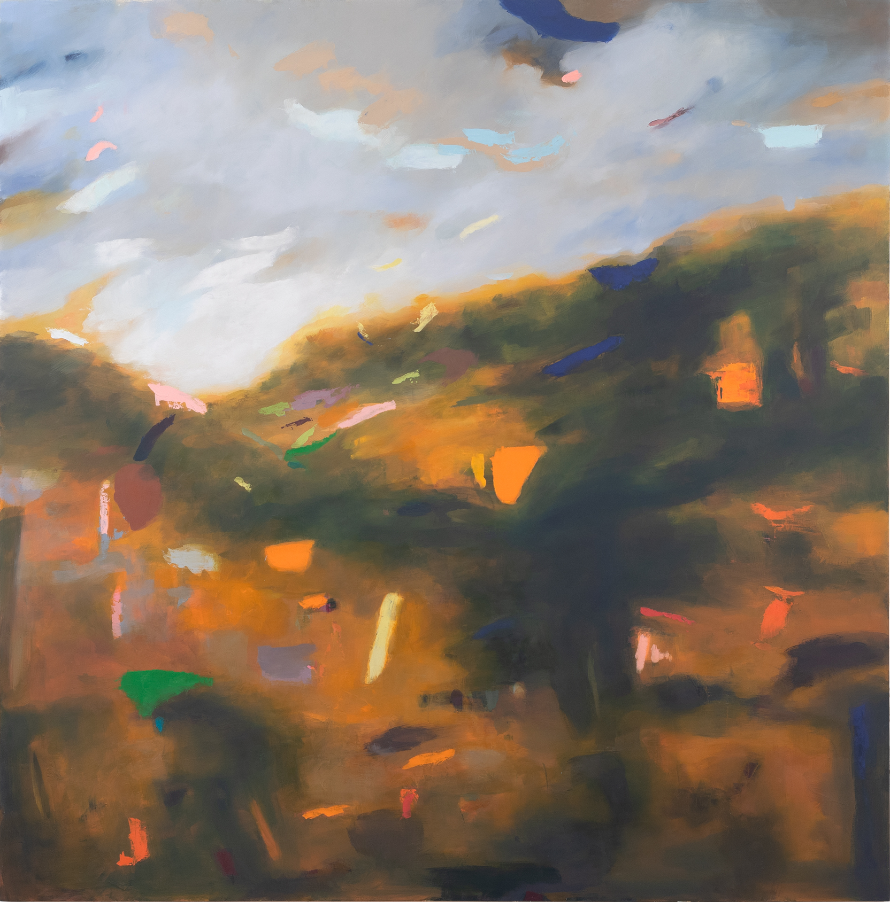
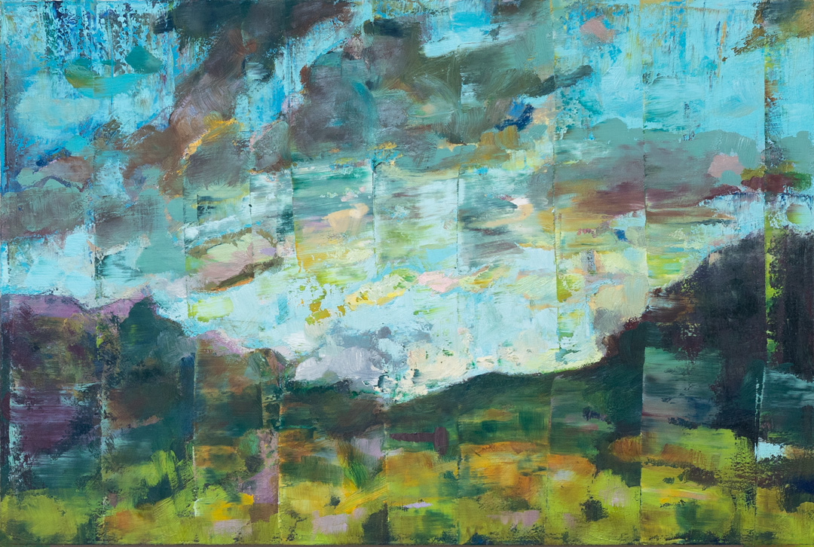
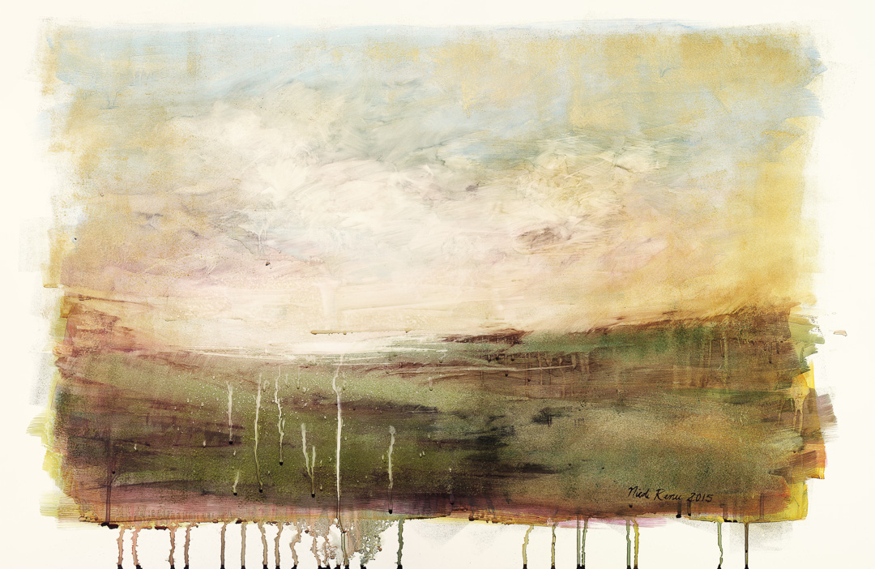
Series of Artwork
To see more samples of work to help you inform your commission, please visit www.nicolereneeryan.com
Between Nowhere and Nothing
From the Remnants series
So Much Like Remembering
From the Parts & Pieces series
This Time Last March
From the Time Between Time Series
The Center of Everything
From the Portal Series
The Middle of Things
From the Watercolor on Yupo Paper series
Between Here and There 4
From the Ripples series
Twoo Pieces of Yesterday
Moveable Landscapes series
Here There and Everywhere
From the Confetti series

Slide 14
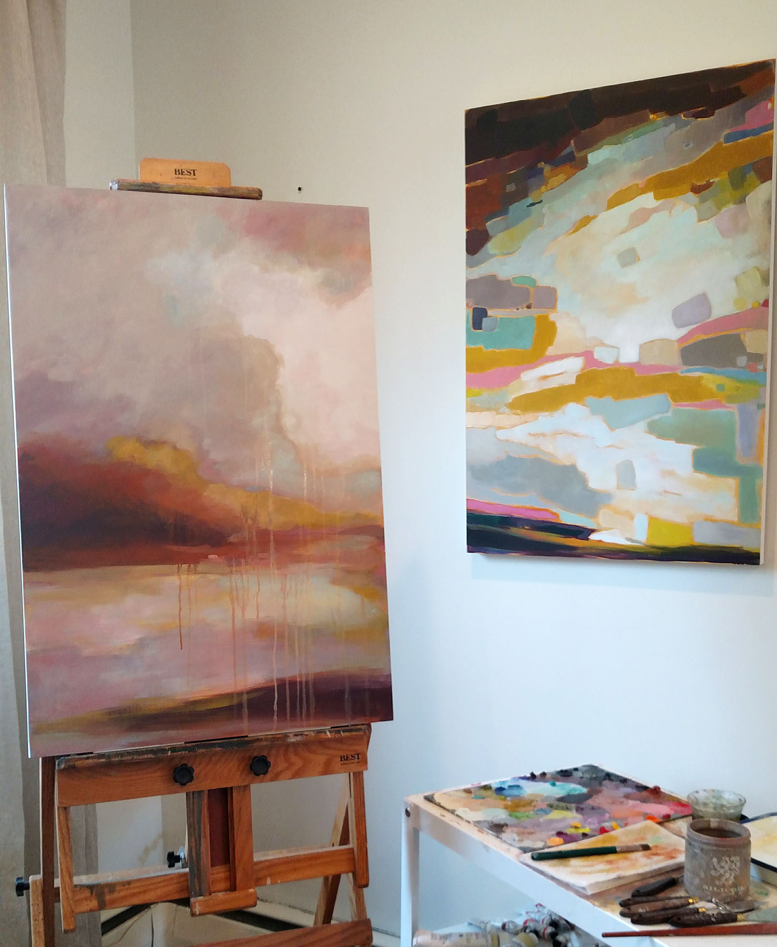
Still have questions…?
Email Nicole: nicole@artbynicolerenee.com

